Slide 1
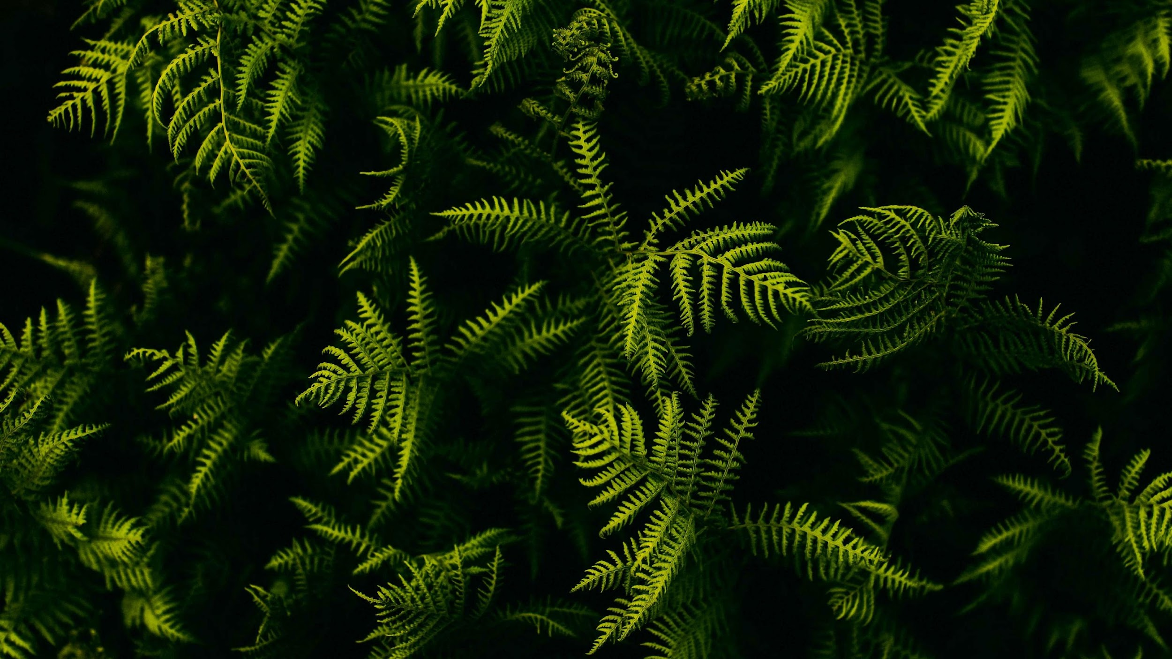



TỔNG LIÊN ĐOÀN LAO ĐỘNG VIỆT NAM
TRƯỜNG ĐẠI HỌC TÔN ĐỨC THẮNG
Extreme Gradient Boosting
(XGBoost)
Người hướng dẫn: Thầy Lê Cung Tưởng
Người thực hiện: Trần Minh Phi
Mã số sinh viên: 51900408

Slide 2




NỘI DUNG
Phần 1
Phần 2
Phần 3
Phần 4
Giới thiệu đề tài
Cơ sở lý thuyết
Thực nghiệm
Tổng kết

Slide 3
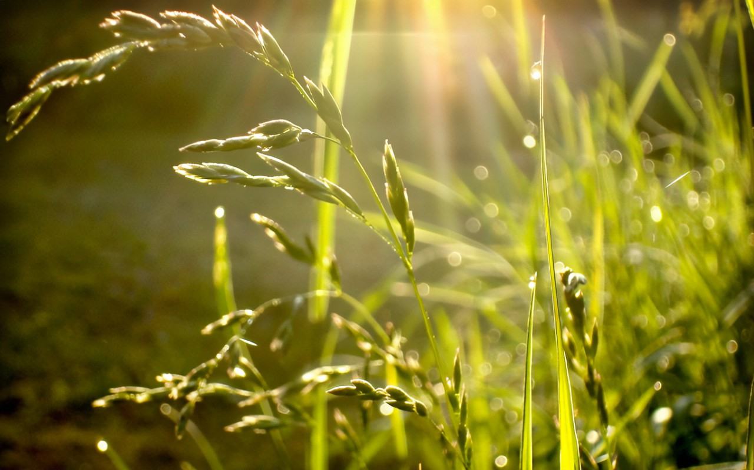




1

Slide 4





1.1 Giới thiệu đề tài

Slide 5

1.2 Lịch sử hình thành
Xgboost được phát triển và hình thành bởi Tianqi Chen.
2016
Thuật toán Gradient Tree Boosting (GTB) được đề xuất do Fiedman và cộng sự.
2000
Tianqi Chen

Slide 6


2

Slide 7

2.1 Khái niệm
XGBoost (Extreme Gradient Boosting) là một giải thuật được base trên gradient boosting, tuy nhiên kèm theo đó là những cải tiến to lớn giúp đạt được những kết quả vượt trội.

Slide 8
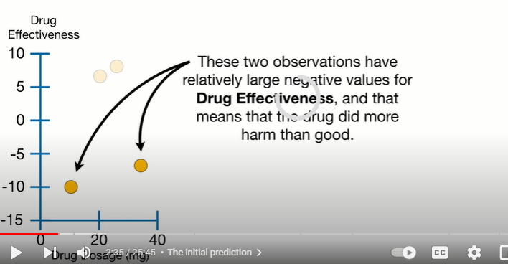
2.2 Đặc tính và nguyên lý hoạt động
Regression
Drug Effectiveness
10
Negative values Drug Effectiveness: Với mg thuốc này thì có hại hơn có lợi
5
0
-5
-10
-15
Drug Posage (mg)
0
20
40

Slide 9
Dosage < 15
-10.5, 6.5, 7.5, -7.5
Similarity = 4
Predicted Drug Effectiveness
0.5
We do this by calculting the Gain of splitting the Residuals into two groups
Drug Effectiveness
-10.5
6.5, 7.5, -7.5
10
Similarity = 101.25
Similarity = 14.08
5
Sum of Residual, Squared
(-10.5 + 6.5 + 7.5 + -7.5)²
0
Similarity Score =
= 4
Number of Residuals + Ⲗ
4 + 0
-5
Regularization
-10
Gain = Left_{Similariry} + Right_{Similarity} – Root_{Similarity}
-15
Drug Posage (mg)
Gain = 101.25 + 14.08 - 4 = 120.33
0
20
40

Slide 10
Dosage < 30
Dosage < 22.5
Similarity = 4
Predicted Drug Effectiveness
0.5
Drug Effectiveness
10
-10.5, 6.5, 7.5
-7.5
-10.5, 6.5
7.5, -7.5
Similarity = 4.08
Similarity = 8
Similarity = 0
5
Similarity = 56.25
0
Gain = 8 + 0 - 4 = 4
Gain = 4.08 + 56.25 - 4 = 56.33
-5
-10
-15
Drug Posage (mg)
0
20
40

Slide 11
(Gain Dosage < 30 ) = 56.33 < (Gain Dosae < 15) = 120.33
(Gain Dosage < 22.5 ) = 4 < (Gain Dosae < 15) = 120.33
Dosage < 15

Slide 12
Predicted Drug Effectiveness
Dosage < 15
Similarity =14.08
0.5
Drug Effectiveness
10
-10.5
Dosage < 22.5
Dosage < 30
5
6.5, 7.5
6.5
7.5, -7.5
-7.5
Similarity = 42.25
Similarity = 98
Similarity = 0
0
Similarity = 56.25
-5
-10
Gain = 98 + 56.25 -14.08 = 140.17
Gain = 42.25 + 0 - 14.08 = 28.17
-15
Drug Posage (mg)
0
20
40

Slide 13
Predicted Drug Effectiveness
Gain = 120.33
Dosage < 15
Gain = 140.17
0.5
Drug Effectiveness
10
-10.5
Dosage < 30
5
6.5, 7.5
-7.5
Similarity = 98
Similarity = 56.25
0
-5
-10
-15
Drug Posage (mg)
0
20
40

Slide 14
Gain = 62.49
Dosage < 15
Sum of Residual, Squared
Gain = 82.9
Similarity Score =
Number of Residuals + 1
-10.5
Dosage < 30
6.5, 7.5
-7.5
So when Ⲗ > 0, it is easier to prune leaves because the values for Gain are smaller
when Ⲗ = 1 …
when Ⲗ = 0 …
Gain = 120.33
Dosage < 15
Gain = 140.17
-10.5
Dosage < 30
Gain = 55.12 + 10.56 - 3.2 = 62.48
6.5, 7.5
-7.5

Slide 15
Gain = 62.49
Dosage < 15
Sum of Residual, Squared
Gain = 82.9
Similarity Score =
-10.5
Dosage < 30
Number of Residuals + Ⲗ
(6.5 + 7.5)²
Dosage < 22.5
-7.5
Similarity Score =
= 65.3
2 + 1
6.5
7.5
6.5²
Similarity Score =
= 21.12
1 + 1
7.5²
Similarity Score =
= 28.12
1 + 1

Slide 16
Gain = 62.49
Dosage < 15
Gain = 82.9
-10.5
Dosage < 30
Similarity = 65.3
Dosage < 22.5
-7.5
Gain = -16.06
6.5
7.5
Gain = Left_{Similariry} + Right_{Similarity} - Root_{Similarity}
Similarity = 21.12
Similarity = 28.12
= 21.12 + 28.12 – 65.3 = -16.06

Slide 17
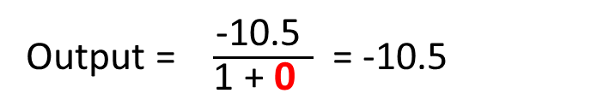
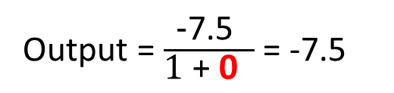
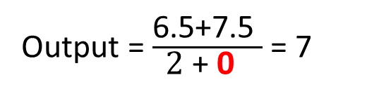
Predicted Drug Effectiveness
Dosage < 15
0.5
Drug Effectiveness
10
-10.5
Dosage < 30
Output = $\frac{\text{-10.5 }}{\text{1 + }\text{0} }$ = -10.5
5
6.5, 7.5
-7.5
0
Output = $\frac{\text{6.5+7.5 }}{\text{2}\text{ + }\text{0} }$ = 7
Output = $\frac{\text{-}\text{7.5 }}{\text{1}\text{ + }\text{0} }$ = -7.5
-5
Sum of Residuals
-10
Output =
Number of Residuals + Ⲗ
-15
Drug Posage (mg)
0
20
40

Slide 18
Predicted Drug Effectiveness
Dosage < 15
+
X
0.5
0.3
Drug Effectiveness
10
-10.5
Dosage < 30
Output = -10.5
5
0.5 + (0.3 x 7) = 2.6
6.5, 7.5
-7.5
Output = 7
Output = -7.5
0
-5
0.5 + (0.3 x -7.5) = -1.75
-10
-15
Drug Posage (mg)
0.5 + (0.3 x -10.5) = -2.65
0
20
40

Slide 19
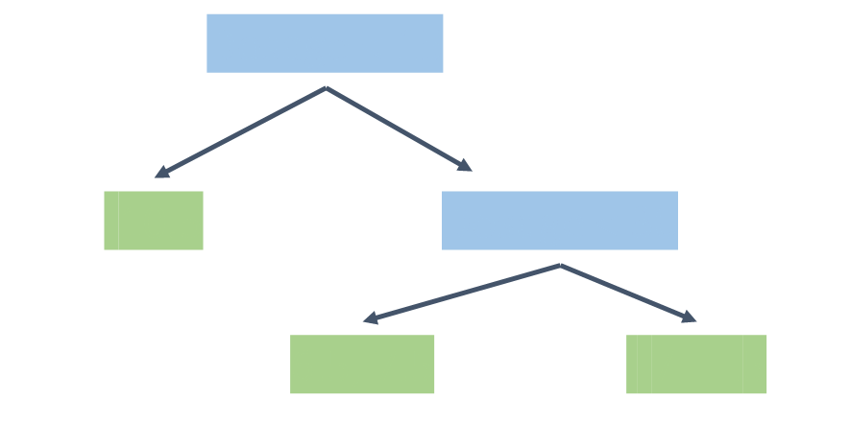
Predicted Drug Effectiveness
Dosage < 15
+
X
0.5
0.3
Drug Effectiveness
10
-10.5
Dosage < 30
Output = -10.5
5
6.5, 7.5
-7.5
Output = 7
Output = -7.5
0
+
-5
0.3 x
-10
+
0.3x
-15
Drug Posage (mg)
0
20
40

Slide 20
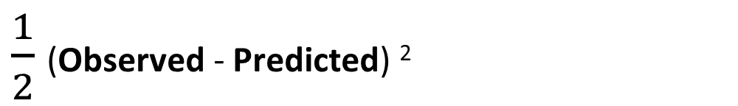
Input: Data ${\{\left(xi,yi\right)\}}_{i=1}^{n}$ and a differentiable Loss Function L(y_{i},F(x))
Gradient Boost
$\frac{1}{2}$(Observed - Predicted) ²
Height (m) | Favorite Color | Gender | Weight (kg)
1.6 | Blue | Male | 88
1.6 | Green | Female | 76
1.5 | Blue | Female | 56
(Observed - Predicted) ²

Slide 21
(Observed - Predicted) ² + (Observed - Predicted) ² + (Observed - Predicted) ²
0.1² + -0.4² + 0.3² = 0.26
Weight
Height

Slide 22
(Observed - Predicted) ² + (Observed - Predicted) ² + (Observed - Predicted) ²
0.1² + -0.4² + 0.3² = 0.26
Weight
1.1² + 0.9² + 2.1² = 6.43
Height

Slide 23
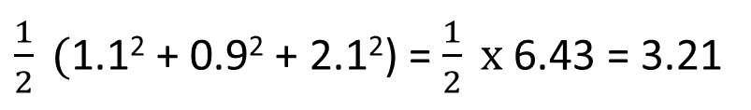
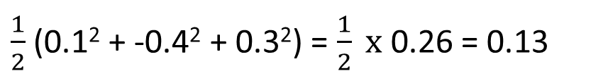
$\frac{1}{2}$(0.1² + -0.4² + 0.3²) = $\frac{1}{2} x$0.26 = 0.13
Weight
$\frac{1}{2} ($1.1² + 0.9² + 2.1²) = $\frac{1}{2} x$6.43 = 3.21
Height

Slide 24
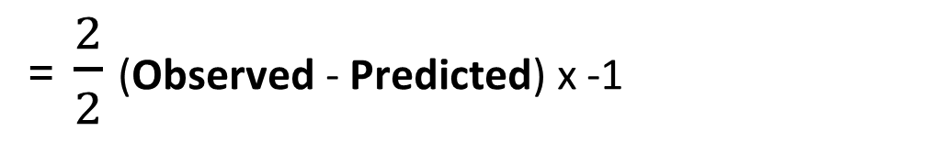
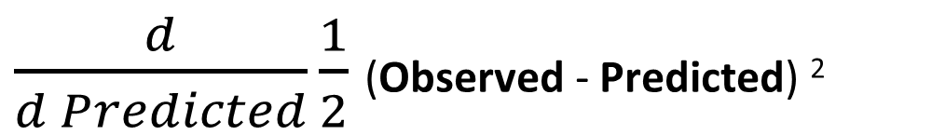
$\frac{d}{d Predicted}\frac{1}{2}$(Observed - Predicted) ²
= $\frac{2}{2}$(Observed - Predicted) x -1
= -(Observed - Predicted)

Slide 25
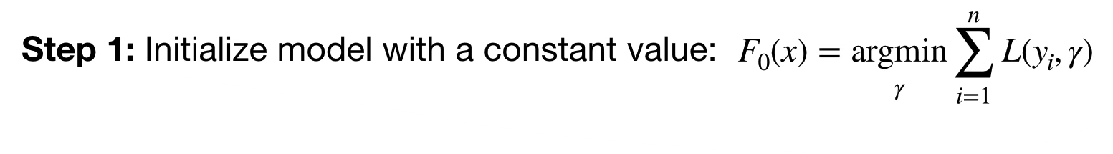
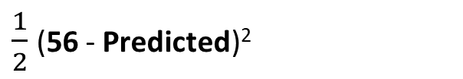
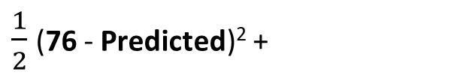
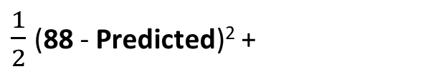
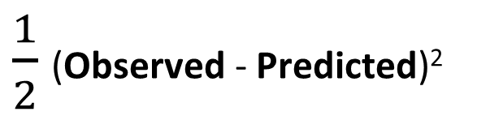
Input: Data ${\{\left(xi,yi\right)\}}_{i=1}^{n}$ and a differentiable Loss Function L(y_{i},F(x))
$\frac{1}{2}$(Observed - Predicted)²
Height (m) | Favorite Color | Gender | Weight (kg)
1.6 | Blue | Male | 88
1.6 | Green | Female | 76
1.5 | Blue | Female | 56
$\frac{1}{2}$(88 - Predicted)² +
$\frac{1}{2}$(76 - Predicted)² +
$\frac{1}{2}$(56 - Predicted)²

Slide 26
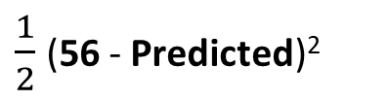
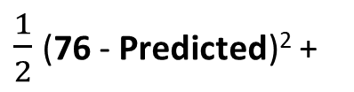
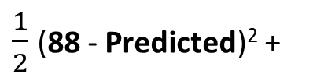
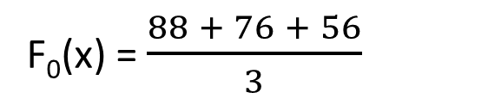
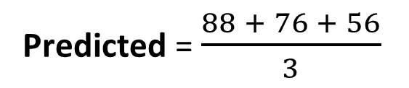

Input: Data ${\{\left(xi,yi\right)\}}_{i=1}^{n}$ and a differentiable Loss Function L(y_{i},F(x))
$\frac{1}{2}$(Observed - Predicted)²
$$\frac{d}{d Predicted}$$
$\frac{1}{2}$(88 - Predicted)² +
-(88 - Predicted)+
$\frac{1}{2}$(76 - Predicted)² +
Predicted = $\frac{88 + 76 + 56}{3}$
-(76 - Predicted)+
= 0
$\frac{1}{2}$(56 - Predicted)²
-(56 - Predicted)
F₀(x) = $\frac{88 + 76 + 56}{3}$
= 73.3

Slide 27
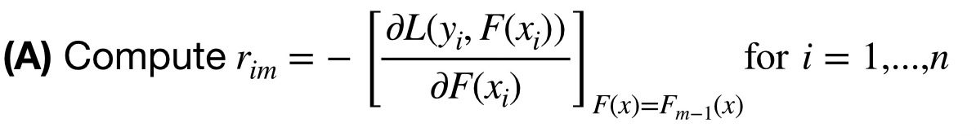


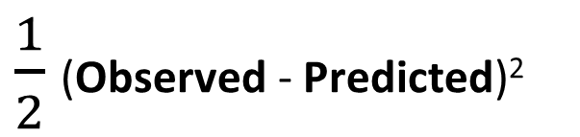

Step 2: for m = 1 to M
Đạo hàm của Loss Function
$\frac{1}{2}$(Observed - Predicted)²
$$\frac{d}{d Predicted}$$
$$F_{m−1}\left(x\right)$$
$$F_{0}\left(x\right)$$
= 73.3
= -(Observed - Predicted)
= (Observed - Predicted)
= (Observed – 73.3)

Slide 28
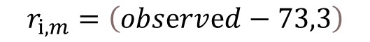
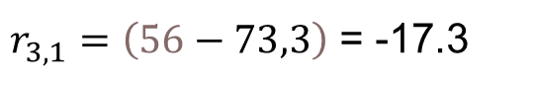
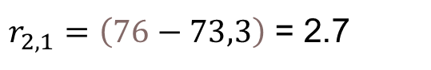

(B) Fit a regression tree to the r_{im} values and create terminal regions R_{jm}, for j= i…J_{m}
$$r_{i,m}=\left(obsⅇrvⅇd−73,3\right)$$
$r_{1,1}=\left(88−73,3\right)$ = 17.4
$r_{2,1}=\left(76−73,3\right)$ = 2.7
$r_{3,1}=\left(56−73,3\right)$ = -17.3
Height (m) | Favorite Color | Gender | Weight (kg) | r_{i,1}
1.6 | Blue | Male | 88 | 14.7
1.6 | Green | Female | 76 | 2.7
1.5 | Blue | Female | 56 | -17.3
Height < 1.55
-17.3
14.7, 2.7
R_{1,1}
R_{2,1}

Slide 29
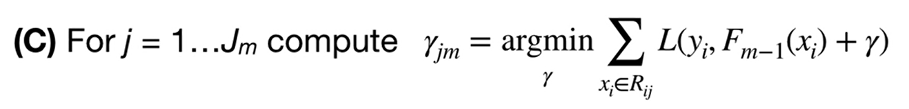
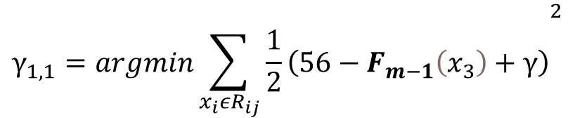
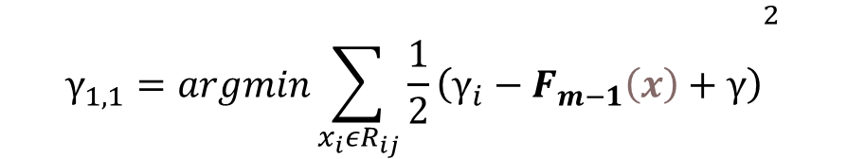
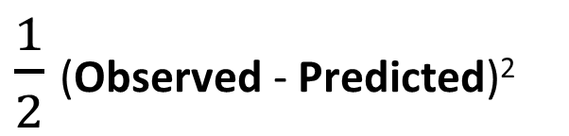
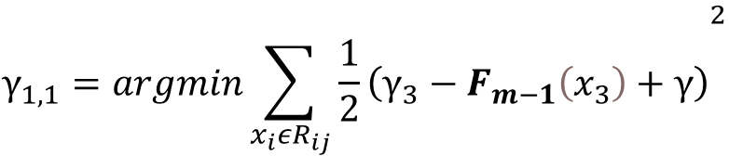
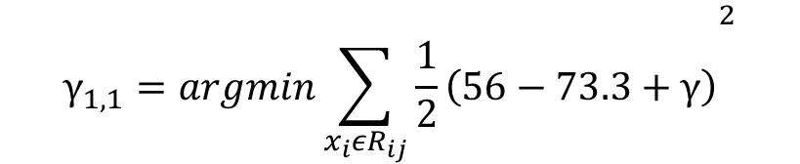
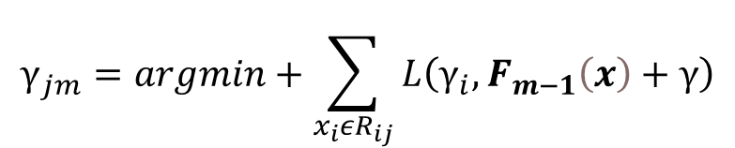
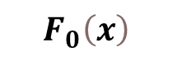
Height (m) | Favorite Color | Gender | Weight (kg) | r_{i,1}
1.6 | Blue | Male | 88 | 14.7
1.6 | Green | Female | 76 | 2.7
1.5 | Blue | Female | 56 | -17.3
Height < 1.55
-17.3
14.7, 2.7
R_{1,1}
R_{2,1}
$\frac{1}{2}$(Observed - Predicted)²
Loss Function
$$γ_{1,1}=argmin{\sum_{{x_{i}εR}_{ij}}{\frac{1}{2}\left(γ_{i}−F_{m−1}\left(x\right)+γ\right)}}^{2}$$
$$γ_{jm}=argmin+\sum_{{x_{i}εR}_{ij}}{L\left(γ_{i},F_{m−1}\left(x\right)+γ\right)}$$
$$γ_{1,1}=argmin{\sum_{{x_{i}εR}_{ij}}{\frac{1}{2}\left(γ_{3}−F_{m−1}\left(x_{3}\right)+γ\right)}}^{2}$$
$$F_{0}\left(x\right)$$
= 73.3
$$γ_{1,1}=argmin{\sum_{{x_{i}εR}_{ij}}{\frac{1}{2}\left(56−F_{m−1}\left(x_{3}\right)+γ\right)}}^{2}$$
$$γ_{1,1}=argmin{\sum_{{x_{i}εR}_{ij}}{\frac{1}{2}\left(56−73.3+γ\right)}}^{2}$$

Slide 30

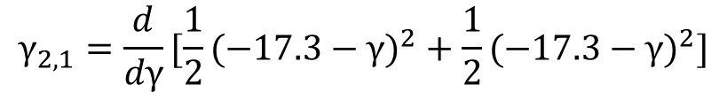
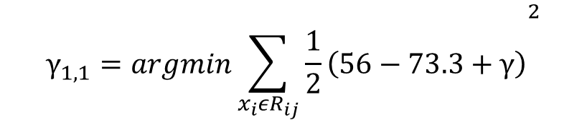

$$γ_{1,1}=argmin{\sum_{{x_{i}εR}_{ij}}{\frac{1}{2}\left(56−73.3+γ\right)}}^{2}$$
$$γ_{1,1}=argmin{\frac{1}{2}(−17.3−γ)}^{2}$$
$$γ_{1,1}={\frac{d}{dγ}\frac{1}{2}(−17.3−γ)}^{2}$$
$$17.3+γ=0$$
$$γ=−17.3$$
$$γ_{2,1}={\frac{d}{dγ}[\frac{1}{2}(−17.3−γ)}^{2}+{\frac{1}{2}(−17.3−γ)}^{2}]$$
$$γ=8.7$$
-14.7 + $γ−2.7+γ=0$

Slide 31
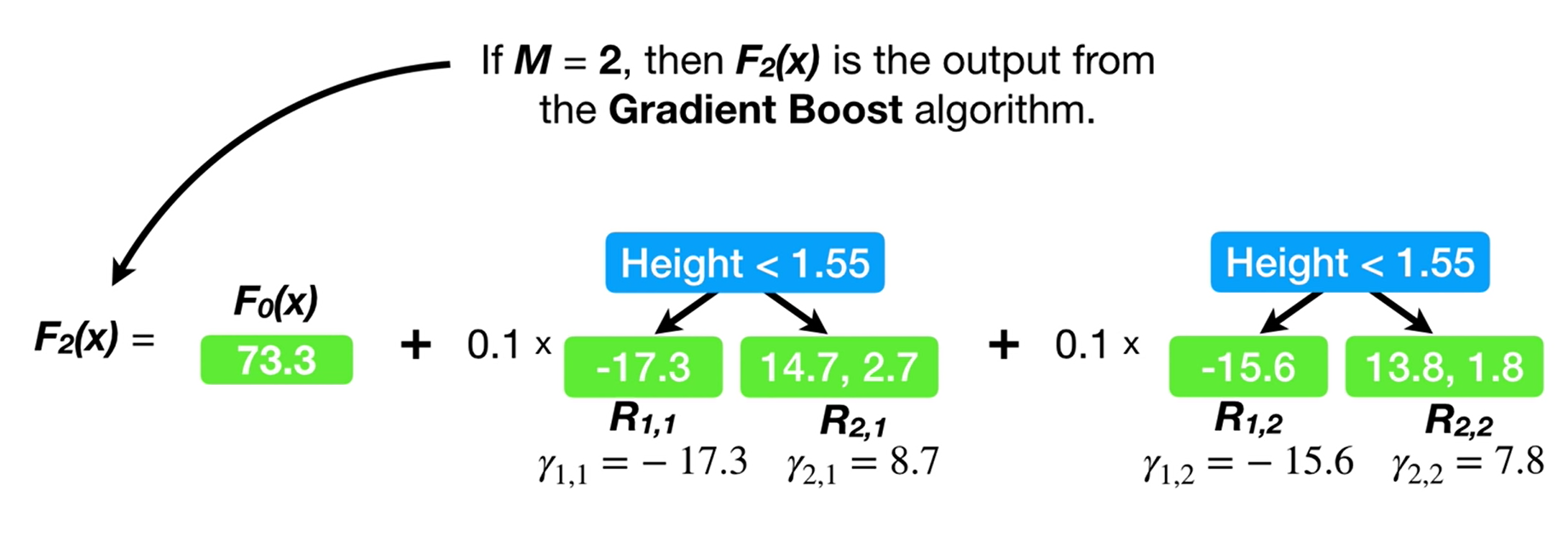
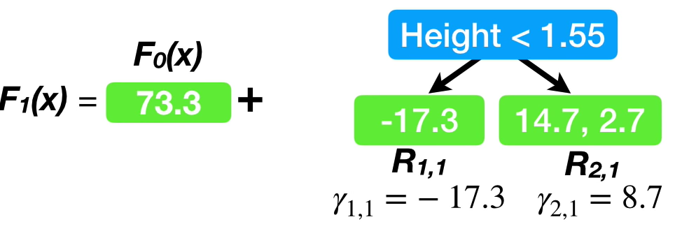
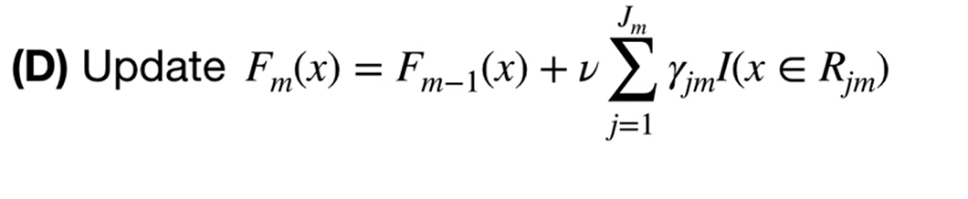
0.1 x
Height (m) | Favorite Color | Gender | Weight (kg)
1.6 | Blue | Male | 88
1.6 | Green | Female | 76
1.5 | Blue | Female | 56
73.3 + 0.1 x 8.7 = 74.2
73.3 + 0.1 x 8.7 = 74.2
73.3 + 0.1 x -17.3 = 71.6

Slide 33
Classification
Input: Data ${\{\left(xi,yi\right)\}}_{i=1}^{n}$ and a differentiable Loss Function L(y_{i},F(x))
Step 2: for m = 1 to M
(B) Fit a regression tree to the r_{im} values and create terminal regions R_{jm}, for j= i…J_{m}

Slide 34
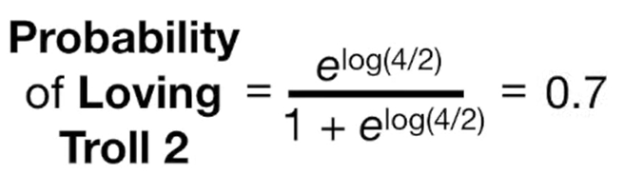
Likes Popcorn | Age | Favorite Color | Loves Troll 2
Yes | 12 | blue | Yes
Yes | 87 | green | Yes
No | 44 | blue | No
Yes | 19 | red | No
No | 12 | green | Yes
No | 14 | blue | Yes

Slide 35
log (4/2)=0.7
Probability of Loving Troll 2 = 0.7
Likes Popcorn | Age | Favorite Color | Loves Troll 2
Yes | 12 | blue | Yes
Yes | 87 | green | Yes
No | 44 | blue | No
Yes | 19 | red | No
No | 12 | green | Yes
No | 14 | blue | Yes
1
0
Troll 2
Doesn’t Love
Love

Slide 36
log (4/2)=0.7
Residual = Observed - Predicted
Probability of Loving Troll 2 = 0.7
Likes Popcorn | Age | Favorite Color | Loves Troll 2 | Residual
Yes | 12 | blue | Yes | 0.3
Yes | 87 | green | Yes | 0.3
No | 44 | blue | No | -0.7
Yes | 19 | red | No | -0.7
No | 12 | green | Yes | 0.3
No | 14 | blue | Yes | 0.3
1
Probability of Loving Troll 2
0
Troll 2
Doesn’t Love
Love

Slide 37
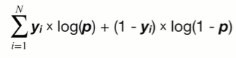
Log(likelihood of the Observed Data given the Prediction)
= 1 x log(p) + (1-1) x log(1-p)
1
= 0.67
0
Troll 2
Doesn’t Love
Love

Slide 38
Log(likelihood of the Observed Data given the Prediction)
= 1 x log(p) + (1-1) x log(1-p)
= 1 x log(0.67) + (1-1) x log(1-0.67)
= log(0.67)
1
= 0.67
Likes Popcorn | Age | Favorite Color | Loves Troll 2
Yes | 12 | blue | Yes
No | 87 | green | Yes
No | 44 | blue | No
0
Troll 2
Doesn’t Love
Love

Slide 39
Log(likelihood of the Observed Data given the Prediction)
= log(0.67) + y2 x log(p) + (1-y2) x log(1-p)
= log(0.67) +1 x log(0.67) + (1-1) x log(1-0.67)
= log(0.67) + log(0.67)
1
= 0.67
Likes Popcorn | Age | Favorite Color | Loves Troll 2
Yes | 12 | blue | Yes
No | 87 | green | Yes
No | 44 | blue | No
0
Troll 2
Doesn’t Love
Love

Slide 40
Log(likelihood of the Observed Data given the Prediction)
= log(0.67) + log(0.67) + y3 x log(p) + (1-y3) x log(1-p)
= log(0.67) + log(0.67) + log(1 - 0.67)
1
= 0.67
Likes Popcorn | Age | Favorite Color | Loves Troll 2
Yes | 12 | blue | Yes
No | 87 | green | Yes
No | 44 | blue | No
0
Troll 2
Doesn’t Love
Love

Slide 41
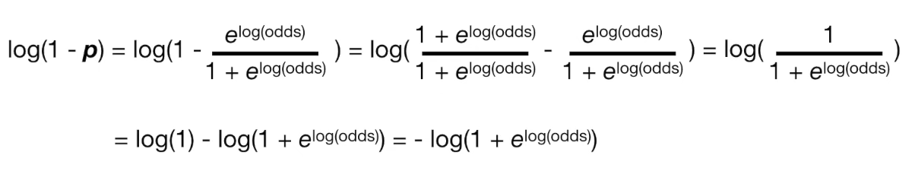
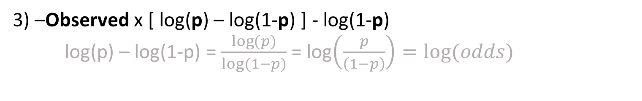
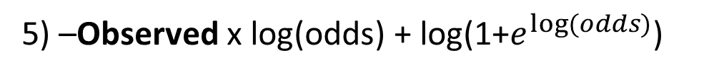
-[ Observed x log(p) + (1 - Observed) x log(1-p) ]
1) –Observed x log(p) – (1 – Observed) x log(1-p)
2) –Observed x log(p) – log(1-p) + Observed) x log(1-p)
3) –Observed x [ log(p) – log(1-p) ] - log(1-p)
log(p) – log(1-p) = $\frac{\log{(p)}}{log⁡(1−p)}$ = log$\left(\frac{p}{\left(1−p\right)}\right)=log⁡(odds)$
4) –Observed x log(odds) - log(1-p)
5) –Observed x log(odds) + log(1+$e^{log⁡(odds)}$)

Slide 42
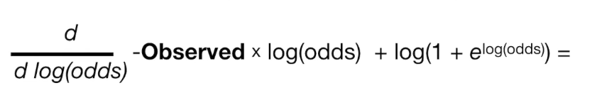
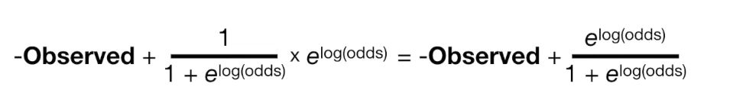
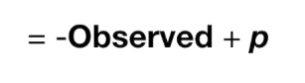

Slide 43
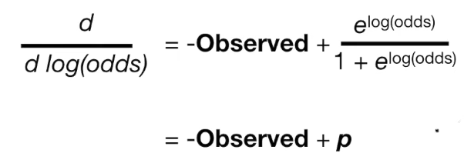
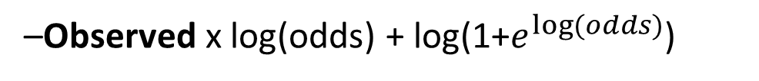
Input: ${Data \left\{ \left( x_{i}, y_{i},\right)\right\}}_{i=1}^{n}$,and a different Loss Function L(yi,F(x))
–Observed x log(odds) + log(1+$e^{log⁡(odds)}$)

Slide 44









Input: ${Data \left\{ \left( x_{i}, y_{i},\right)\right\}}_{i=1}^{n}$,and a different Loss Function L(yi,F(x))
Step 1: Initialize model with a constant value:
–Observed x log(odds) + log(1+$e^{log⁡(odds)}$)
–Observed x gamma + log(1+$e^{gamma}$)
Likes Popcorn | Age | Favorite Color | Loves Troll 2
Yes | 12 | blue | Yes
No | 87 | green | Yes
No | 44 | blue | No
$$−1+ \frac{e^{log⁡(odds)}}{1+e^{log⁡(odds)}}$$
–1 x log(odds) + log(1+$e^{log⁡(odds)}$)
$$−1+ \frac{e^{log⁡(odds)}}{1+e^{log⁡(odds)}}$$
–1 x log(odds) + log(1+$e^{log⁡(odds)}$)
$$−0+ \frac{e^{log⁡(odds)}}{1+e^{log⁡(odds)}}$$
–0 x log(odds) + log(1+$e^{log⁡(odds)}$)

Slide 45



Input: ${Data \left\{ \left( x_{i}, y_{i},\right)\right\}}_{i=1}^{n}$,and a different Loss Function L(yi,F(x))
Step 1: Initialize model with a constant value:
$$−1+ \frac{e^{log⁡(odds)}}{1+e^{log⁡(odds)}}$$
-1 + p
$$−1+ \frac{e^{log⁡(odds)}}{1+e^{log⁡(odds)}}$$
-1 + p
-2 + 3 x p = 0
p = 2/3
$$−0+ \frac{e^{log⁡(odds)}}{1+e^{log⁡(odds)}}$$
-0 + p

Slide 46


Input: ${Data \left\{ \left( x_{i}, y_{i},\right)\right\}}_{i=1}^{n}$,and a different Loss Function L(yi,F(x))
Step 1: Initialize model with a constant value:
p = 2/3
Log(odds) = log($\frac{2/3}{1−2/3}$)= log($\frac{2}{1}$)
Likes Popcorn | Age | Favorite Color | Loves Troll 2
Yes | 12 | blue | Yes
No | 87 | green | Yes
No | 44 | blue | No
–Observed x log(odds) + log(1+$e^{log⁡(odds)}$)

Slide 47
Input: ${Data \left\{ \left( x_{i}, y_{i},\right)\right\}}_{i=1}^{n}$,and a different Loss Function L(yi,F(x))
Step 1: Initialize model with a constant value:
= log(2/1) = 0.69

Slide 48

Step 2: for m = 1 to M:

Slide 49

Step 2: for m = 1 to M:
$\frac{d}{d log⁡(odds)}$ –Observed x log(odds) + log(1+$e^{log⁡(odds)}$)
= (-Observed + $\frac{e^{log⁡(odds)}}{1+e^{log⁡(odds)}}$)

Slide 50


Step 2: for m = 1 to M:
-1 (-Observed + $\frac{e^{log⁡(odds)}}{1+e^{log⁡(odds)}}$)
=(Observed - $\frac{e^{log⁡(odds)}}{1+e^{log⁡(odds)}}$)

Slide 51


Step 2: for m = 1 to M:
Observed – p = Pseudo Residual
= log(2/1) = 0.69
(Observed - $\frac{e^{log⁡(odds)}}{1+e^{log⁡(odds)}}$)
=(Observed - $\frac{e^{log⁡(2/1)}}{1+e^{log⁡(2/1)}}$) =(Observed - $\frac{2}{1+2}$) =(Observed - 0.67)

Slide 52




Step 2: for m = 1 to M:
Likes Popcorn | Age | Favorite Color | Loves Troll 2 | $$r_{i,1}$$
Yes | 12 | blue | Yes | 0.33
No | 87 | green | Yes | 0.33
No | 44 | blue | No | -0.67
$r_{1,1}$=(Observed - 0.67)= 1 – 0.67 = 0.33
$r_{2,1}$=(Observed - 0.67)= 1 – 0.67 = 0.33
$r_{3,1}$=(Observed - 0.67)= 0 – 0.67 = -0.67

Slide 53
(B) Fit a regression tree to the r_{im} values and create terminal regions R_{jm}, for j= i…J_{m}
Likes popcorn
Likes Popcorn | Age | Favorite Color | Loves Troll 2 | $$r_{i,1}$$
Yes | 12 | blue | Yes | 0.33
No | 87 | green | Yes | 0.33
No | 44 | blue | No | -0.67
0.33
0.33, -0.7
R_{1,1}
R_{2,1}

Slide 54
Likes popcorn
0.33
0.33, -0.7
R_{1,1}
R_{2,1}

Slide 55
Likes popcorn
Likes Popcorn | Age | Favorite Color | Loves Troll 2 | $$r_{i,1}$$
Yes | 12 | blue | Yes | 0.33
No | 87 | green | Yes | 0.33
No | 44 | blue | No | -0.67
0.33
0.33, -0.7
R_{1,1}
R_{2,1}

Slide 56


–Observed x log(odds) + log(1+$e^{log⁡(odds)}$)

Slide 57



= 0

Slide 58






Residual
=

Slide 59




=
=

Slide 60


= p x (1-p)

Slide 61




Slide 62
Likes popcorn
0.33
0.33, -0.7
R_{1,1}
R_{2,1}

Slide 63


Slide 64


Likes Popcorn | Age | Favorite Color | Loves Troll 2 | $$r_{i,1}$$
Yes | 12 | blue | Yes | 0.33
No | 87 | green | Yes | 0.33
No | 44 | blue | No | -0.67
Likes popcorn
0.33
0.33, -0.7
R_{1,1}
R_{2,1}

Slide 65






$$≈$$

Slide 66



Slide 67



Slide 68

Likes Popcorn | Age | Favorite Color | Loves Troll 2 | $$r_{i,1}$$
Yes | 12 | blue | Yes | 0.33
No | 87 | green | Yes | 0.33
No | 44 | blue | No | -0.67

Slide 69


Slide 70


Likes popcorn
0.33
0.33, -0.7
R_{1,1}
R_{2,1}

Slide 71


Likes Popcorn | Age | Favorite Color | Loves Troll 2 | $$r_{i,1}$$
Yes | 12 | blue | Yes | 0.33
No | 87 | green | Yes | 0.33
No | 44 | blue | No | -0.67
0.69 + 0.8 x 1.5 = 1.89
0.69 + 0.8 x -0.77 = 0.07
0.69 + 0.8 x -0.77 = 0.07

Slide 72
2.2 Đặc tính và nguyên lý hoạt động
GBM
Bước 1: Train Decision Tree
Bước 2: Tính Error
Bước 3: Train Decision Tree mới để dự đoán Error (same input, khác output)
Bước 4: Tính Error trên việc “Dự đoán Error” Quay lại Bước 2, coi Error of Error là Error và lặp lại quá trình

Slide 73





2.2 Đặc tính và nguyên lý hoạt động
XGBoost
Tree 1
Input: age, gender, occupation,…
Age < 15
Y
N
Is male?
Y
N
+2
+0.1
-1

Slide 74
2.2 Đặc tính và nguyên lý hoạt động
XGBoost
Tree 2
Input: age, gender, occupation,…
Use computer daily
Y
N
+0.9
-0.9

Slide 75





2.2 Đặc tính và nguyên lý hoạt động
Tree 1
Tree 2
Age < 15
Use computer daily
Y
N
Y
N
Is male?
Y
N
+0.9
+2
+0.1
-1
-0.9
f( ) = 2 + 0,9 = 2,9
f( ) = -1 - 0,9 = -1,9

Slide 76
2.2 Đặc tính và nguyên lý hoạt động
XGBoost
Mã nguồn mở với ~350 contributors và ~3,600 commits trên Gihub, XGBoost cho thấy những khả năng ứng dụng đáng kinh ngạc của mình như:
●XGBoost có thể được sử dụng để giải quyết được tất cả các vấn đề từ hồi quy (regression), phân loại (classification), ranking và giải quyết các vấn đề do người dùng tự định nghĩa.
● XGBoost hỗ trợ trên Windows, Linux và OS X.
● Hỗ trợ tất cả các ngôn ngữ lập trình chính bao gồm C ++, Python, R, Java, Scala và Julia.

Slide 77

2.2 Đặc tính và nguyên lý hoạt động
So sánh XGBoost và GBM
1
Tốc độ xử lý
2
Sự linh hoạt
3
Tự động cắt tỉa

Slide 78

3

Slide 79

4

